Slide 1
Enzymes
Dr. B. Usha

Slide 2
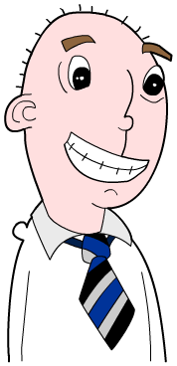
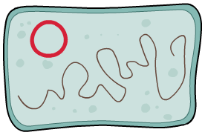
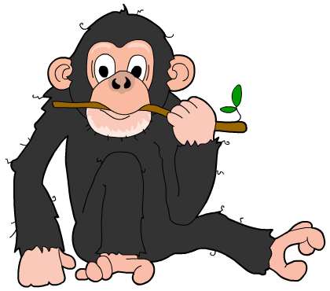
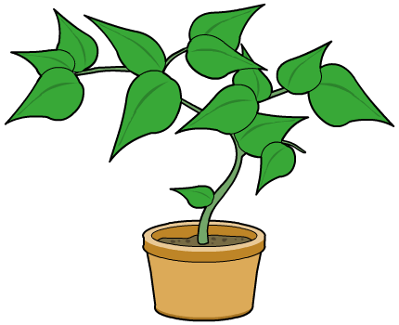
WHAT ARE ENZYMES
Enzymes are biological catalysts – they speed up the chemical reactions that take place inside all cells, but without being used up in the process.
There are many thousands of different types of enzyme, and each one catalyzes a different reaction.
Enzymes occur naturally in all organisms, but they are increasingly being used in industrial processes.

Slide 3
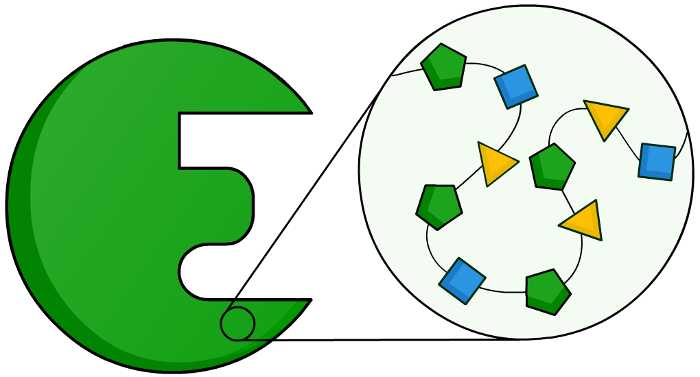
What are enzymes made of?
Enzymes are protein molecules, and so are made up of amino acids. Most enzymes contain between 100 and 1,000 amino acids.
These amino acids are joined together in a long chain, which is folded to produce a unique 3D structure.

Slide 4
Enzymes: true or false?

Slide 5
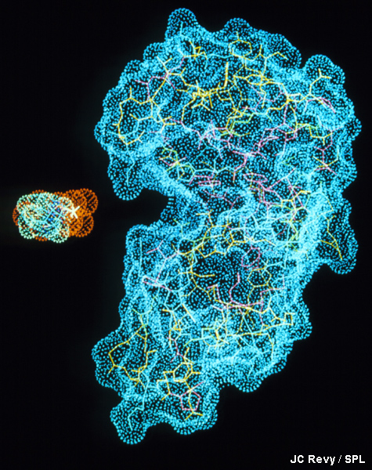
Why are enzymes so specific?
Enzymes are very specific about which reactions they catalyze. Only molecules with exactly the right shape will bind to the enzyme and react. These are the reactant, or substrate, molecules.
The part of the enzyme to which the reactant binds is called the active site.
This is a very specific shape and the most important part of the enzyme.

Slide 6




What happens at the active site?
In the same way that a key fits into a lock, so a substrate is thought to fit into an enzyme’s active site. The enzyme is the lock, and the reactant is the key.
+
↔
↔
+
enzyme
enzyme
↔
enzyme-reactant complex
↔
+
+
reactant
products

Slide 7
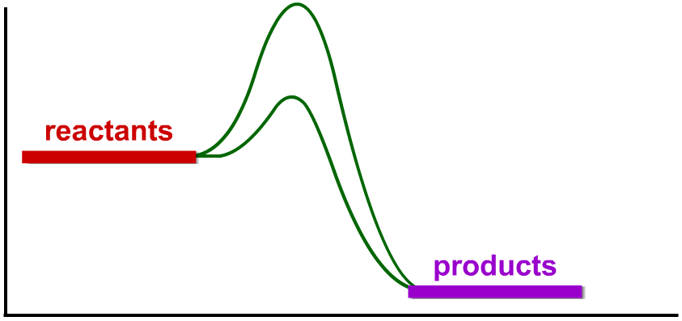
Why do enzymes speed up reactions?
Enzymes speed up reactions by lowering the activation energy (E_{a}) of a reaction. The activation energy is the energy needed to start a reaction.
Different reactions have different activation energies.
energy (kJ)
reaction (time)

Slide 8
Factors affecting enzymes
The rate of enzyme–catalyzed reactions depends on several factors. What are some of these?
Factors that affect the rate of a reaction include:
temperature
substrate concentration
pH
surface area
enzyme concentration
pressure.
All enzymes work best at only one particular temperature and pH: this is called the optimum.
Different enzymes have different optimum temperatures and pH values.

Slide 9
Enzyme inhibitors

Slide 10
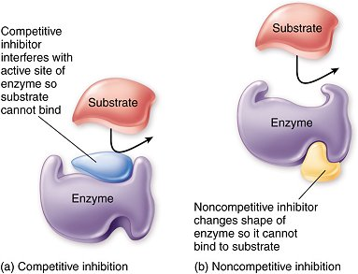
Enzyme Inhibitors

Slide 11
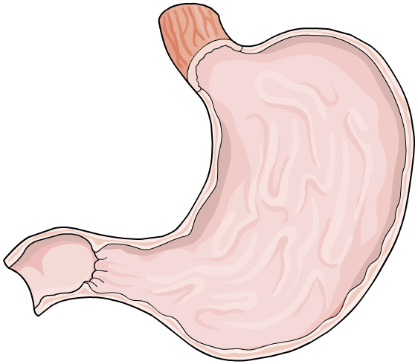

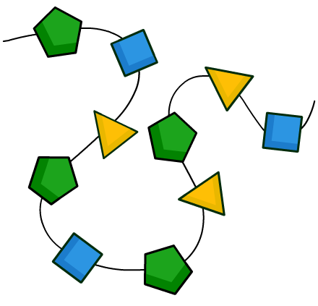
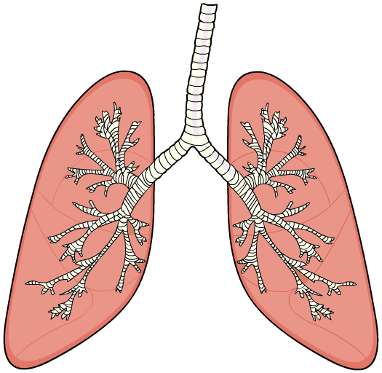
Enzymes in life
Enzymes catalyze the thousands of reactions that need to take place in order to maintain life. What are some of these reactions?
digestion
respiration
photosynthesis (plants and some bacteria)
protein synthesis.

Slide 12
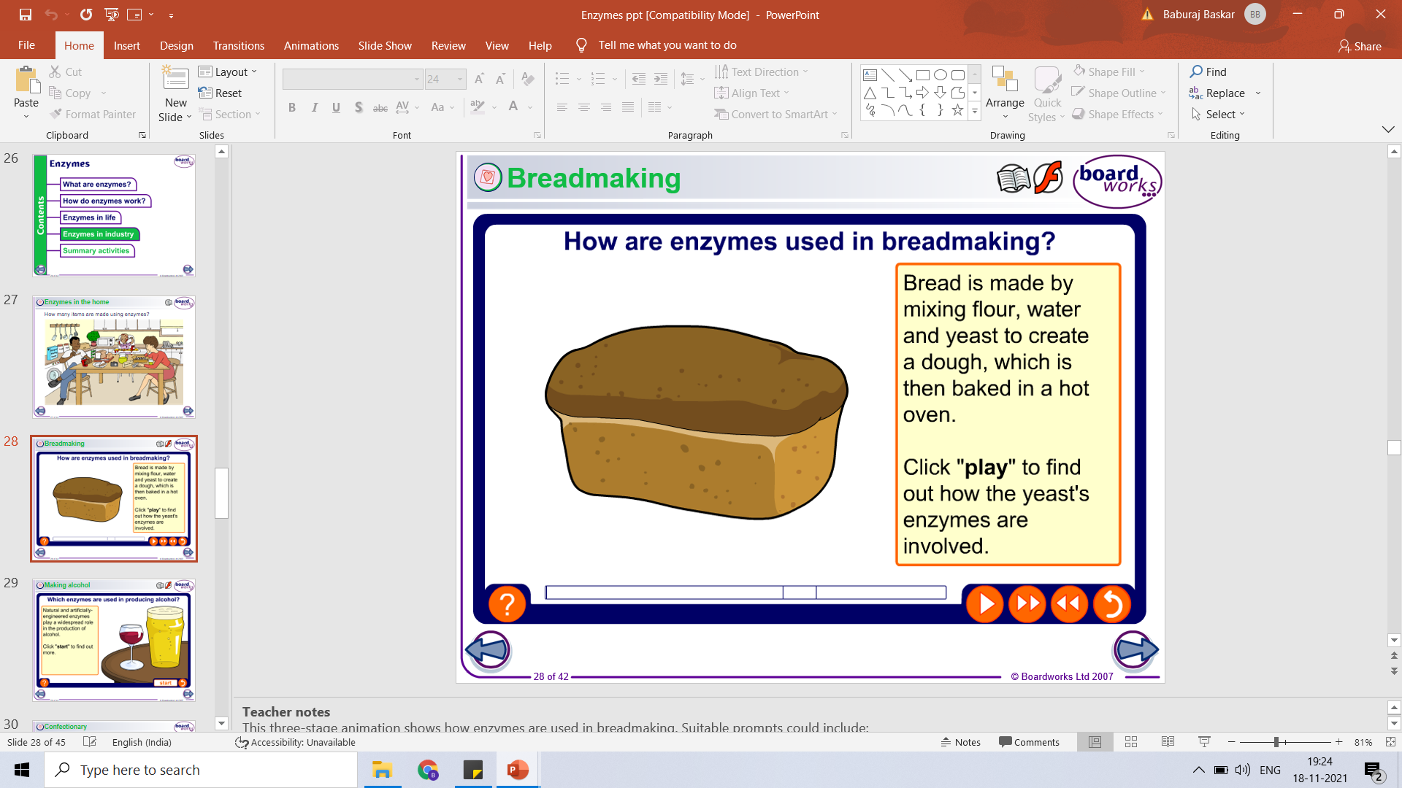
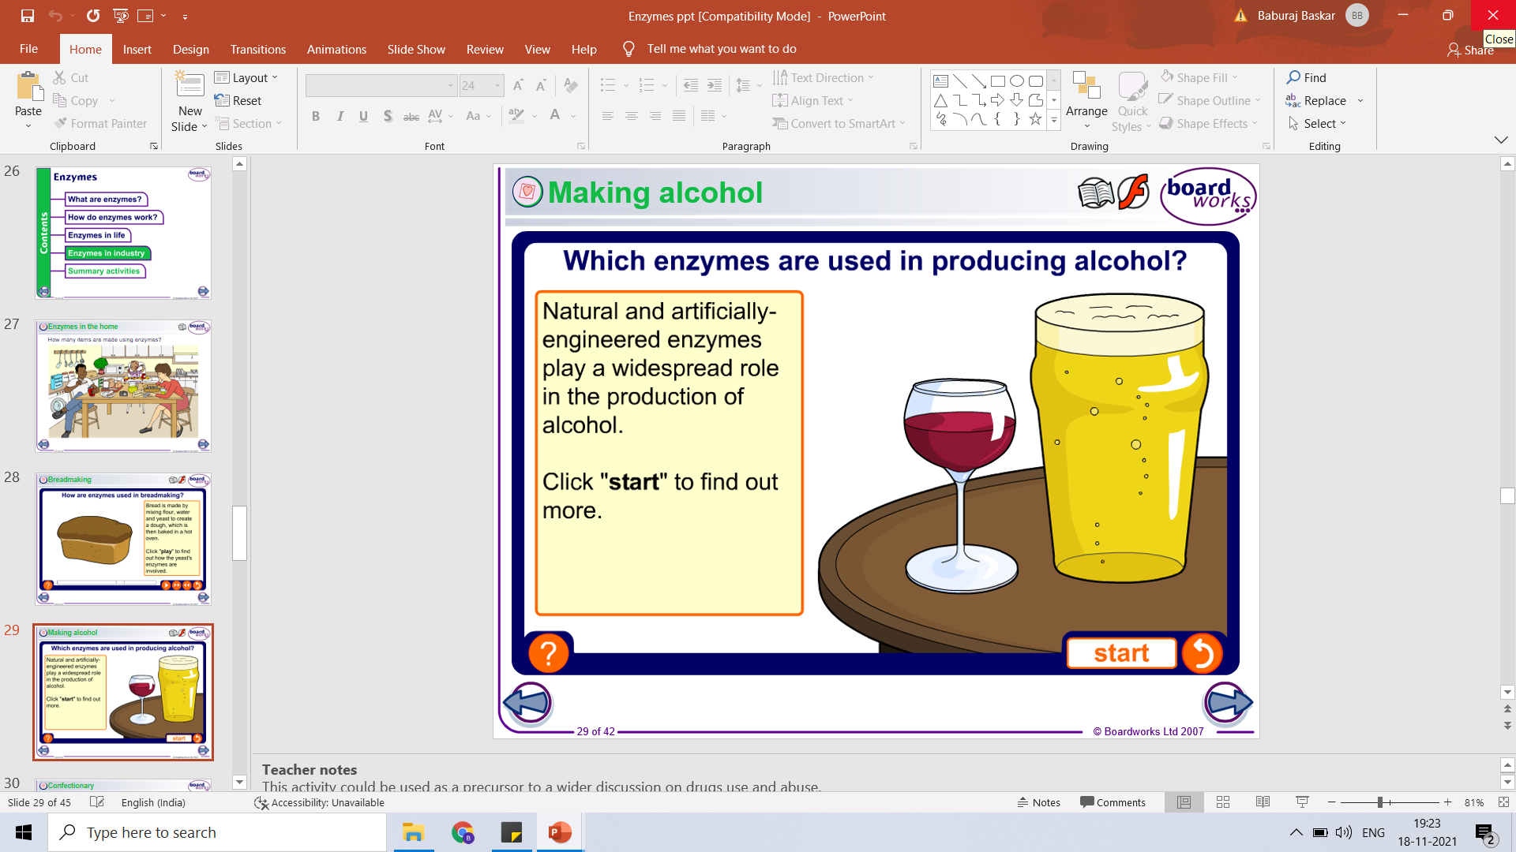
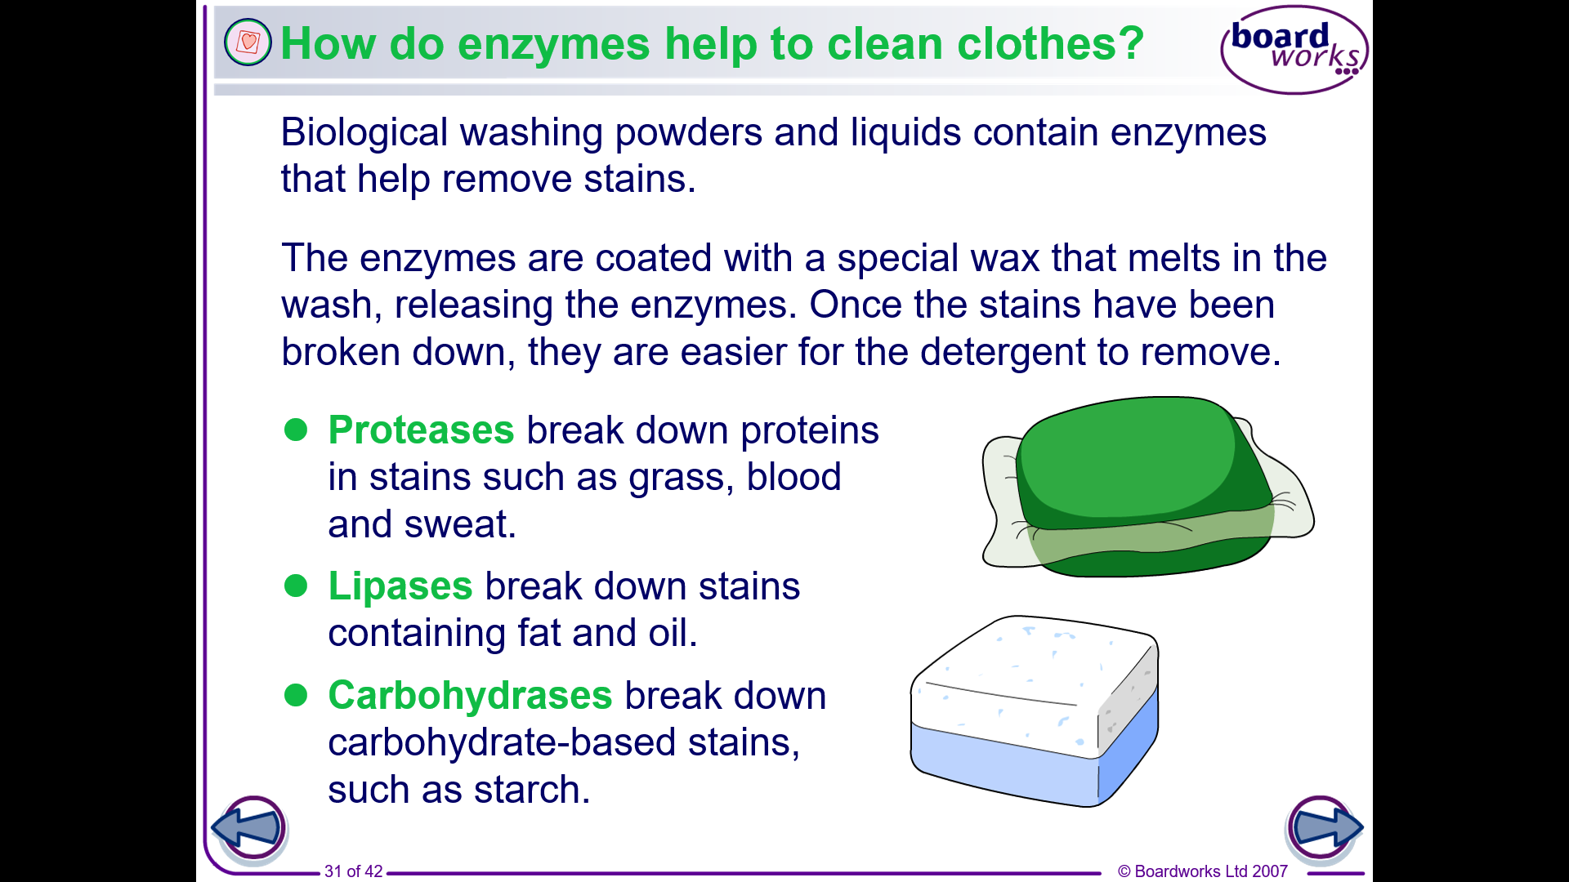
Enzymes in industry

Slide 13
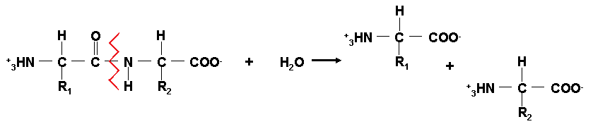
Proteases
What do proteases do?
Proteases cleave proteins by a hydrolysis reaction – the addition of
a molecule of water to a peptide bond

Slide 14
Mechanistic Sets of Proteases
set feature inhibitor examples function
Serine protease active site serine fluorophosphates trypsin digestion
thrombin blood coagulation
plasmin lysis of blood clots
coccoonase mechanical
subtilisin digestion
acrosin sperm penetration
Cysteine protease active site cysteine iodoacetate papain digestion
strept. proteinase digestion
cathepsin B intracell. digestion
Acid protease acidic pH optimum diazoketones pepsin digestion
chymosin milk coagulation
Metalloproteases Zn²⁺, o-phenanthroline carboxypeptidase digestion
Zn²⁺, Ca²⁺ o-phenanthroline thermolysin digestion

Slide 15
Protease Applications in Food Processing
Basic rationale: Proteases are a powerful tool for modifying the properties of food proteins.
Improved digestibility
Improved solubility
Modified functional properties: emulsification, fat-binding, water-binding, foaming properties, gel strength, whipping properties, etc.
Improved flavor & palatability
Improved processing: viscosity reduction, improved drying, etc.

Slide 16
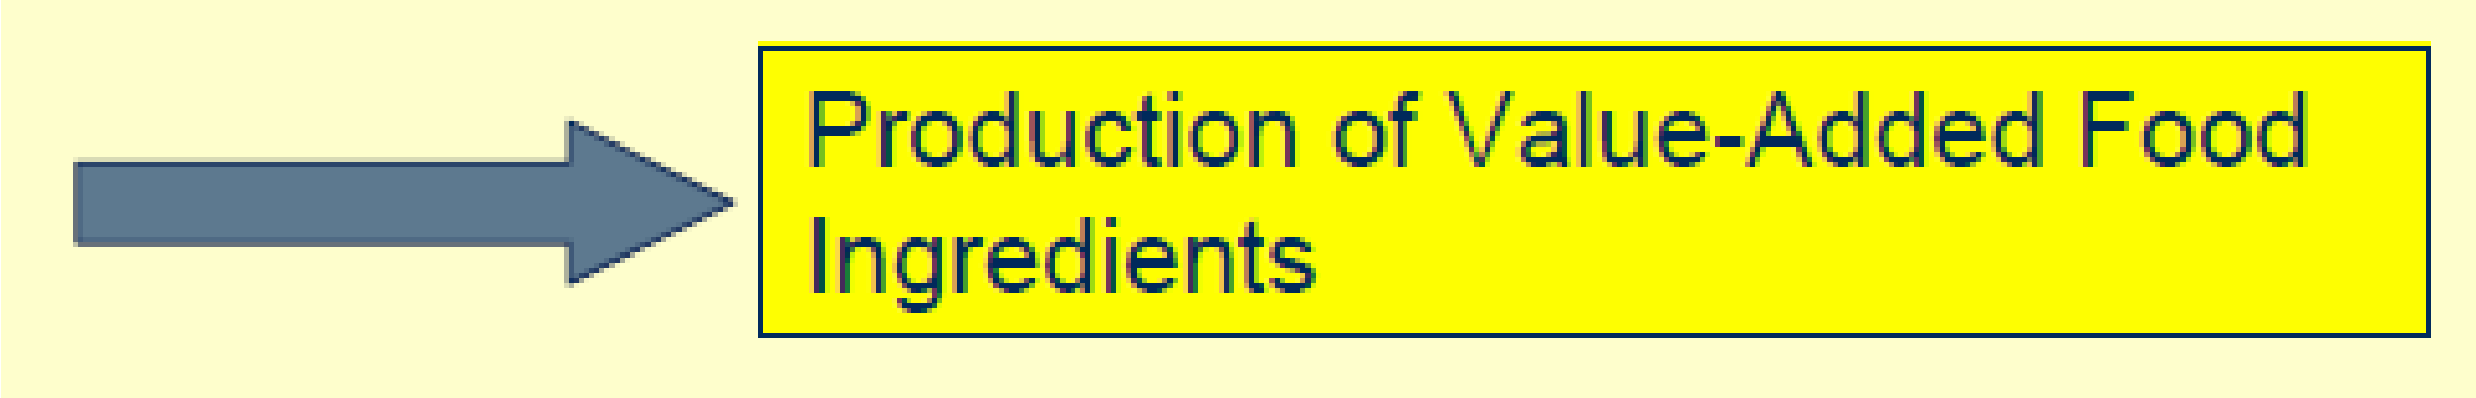
Protease Applications in Food Processing
Proteases are also used in a wide range of foods & food processing applications.
Dairy: milk coagulation, flavor development
Baking: gluten development
Fish & seafood processing: fishmeals, enhanced oil recovery, aquaculture
Animal protein processing: improved digestibility, reduced allergenicity, improved flavor, meat tenderization
Plant protein processing: improved functionality & processing, generation of bio-active peptides.
Yeast hydrolysis: flavor compounds.

Slide 17
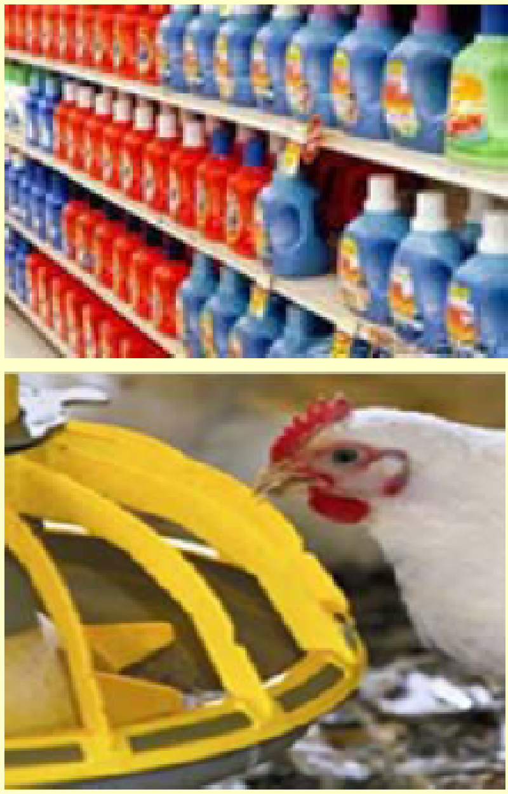
Nonfood Protease Applications
Medicine
Pharmacology & drug manufacture
Laundry & dishwashing detergents (#1)
Hard surface cleaning formulations
Contact lens cleaning formulations
Waste treatment
Industrial applications
Fermentation (fuel EtOH, etc.)
Chondroitin & heparin production
Animal feed additives
Digestive supplements

Slide 18
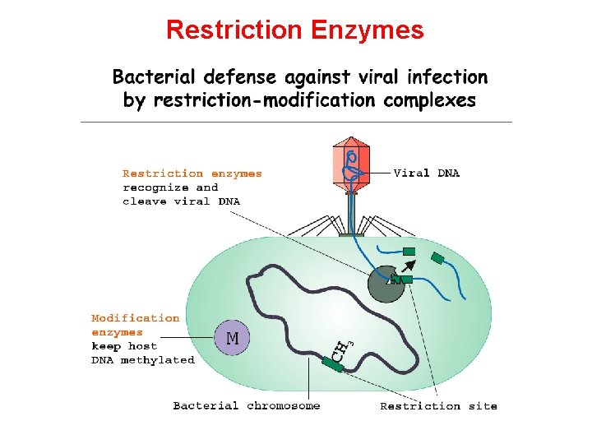
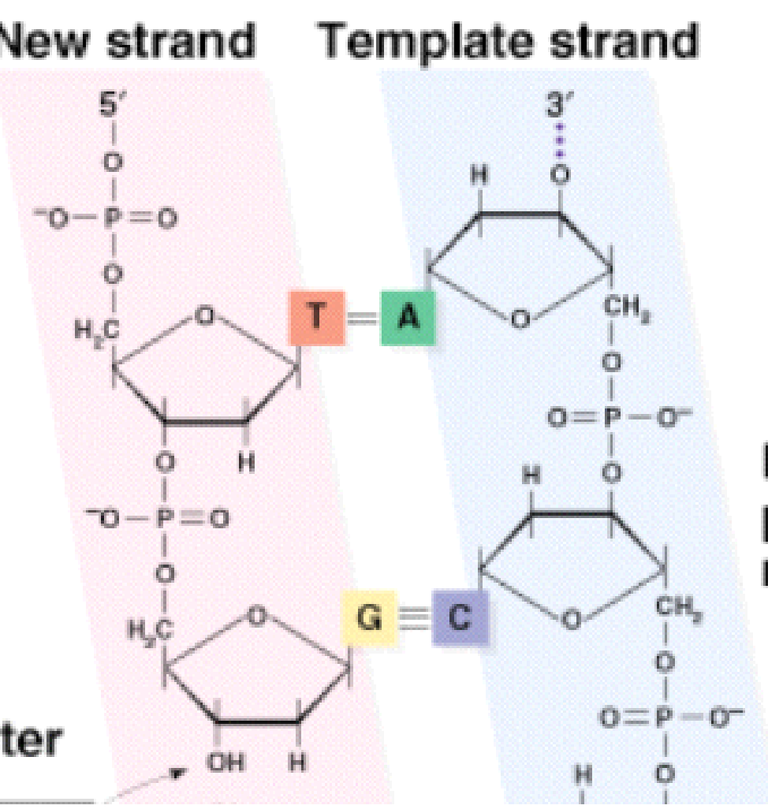
Restriction enzymes- Molecular scissors
Restriction
enzyme

Slide 19
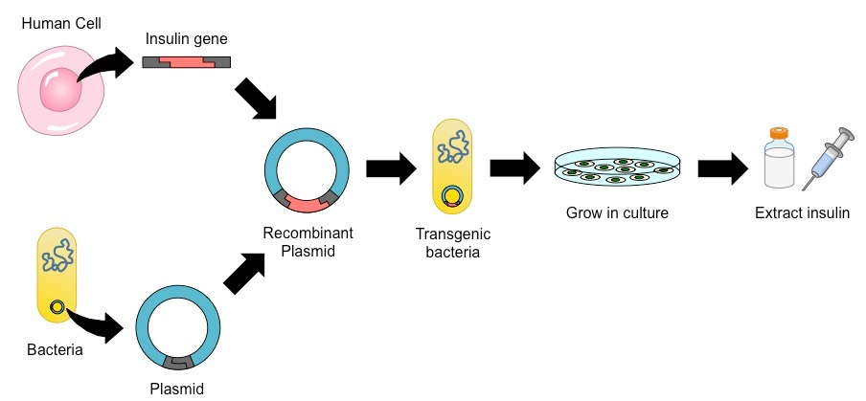
Recombinant insulin

Slide 20
Most restriction enzymes occur naturally in bacteria.
Protect bacteria against viruses by cutting up viral DNA.
Bacteria protects their DNA by modifying possible restriction sites (methylation).
More than 400 restriction enzymes have been isolated.
Names typically begin with 3 italicized letters.
Enzyme Source
EcoRI E. coli RY13
HindIII Haemophilus influenzae Rd
BamHI Bacillus amyloliquefaciens H
Many restriction sites are palindromes of 4-, 6-, or 8-base pairs. GAATTC
Short restriction site sequences occur more frequently in the genome than longer restriction site sequences, e.g., (1/4)n.

Slide 21
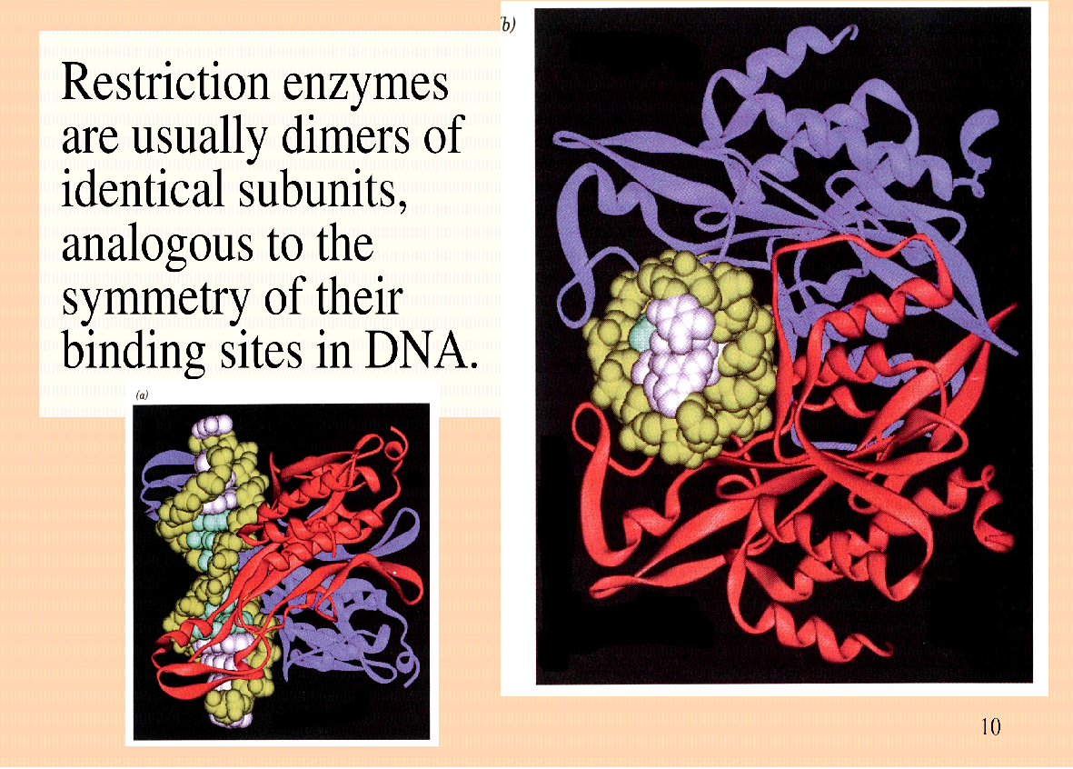
Structure of a restriction endonuclease

Slide 22
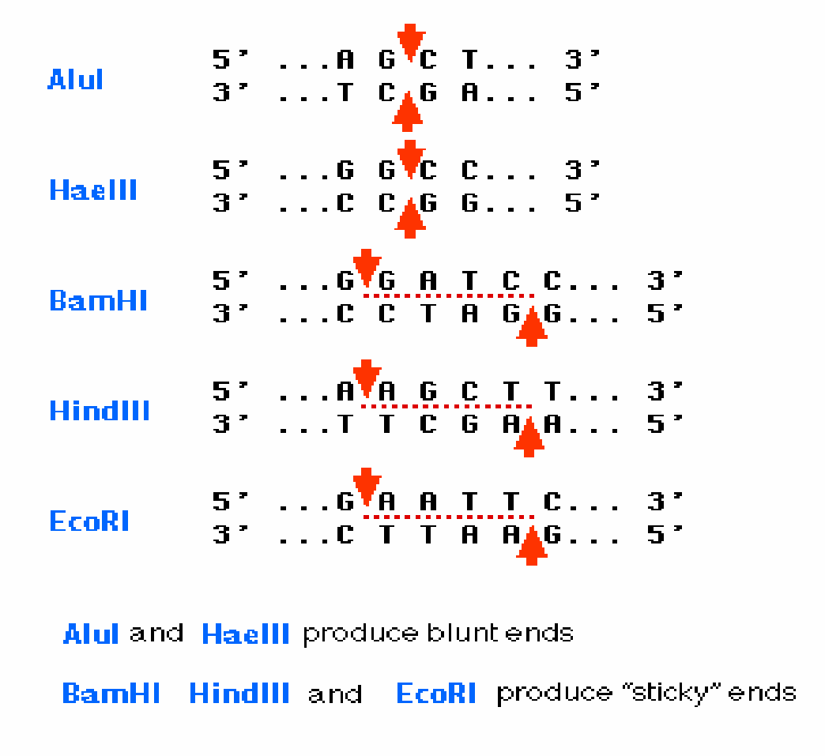
Patterns of DNA cutting by restriction enzymes
Base pairing between
overhangs with complementary
sequences enables two fragments
to be joined by another enzyme
DNA Ligase.
A sticky end fragment can be ligated not only to fragment from which it was originally cleaved, but also to any other fragment with a compatible sticky end.
The result is a molecule of recombinant DNA (rDNA)
Recombinant DNA:
DNA molecules constructed in vitro, consisting of DNA from 2 or more sources (i.e. cloning vector with foreign DNA inserted)

Slide 23
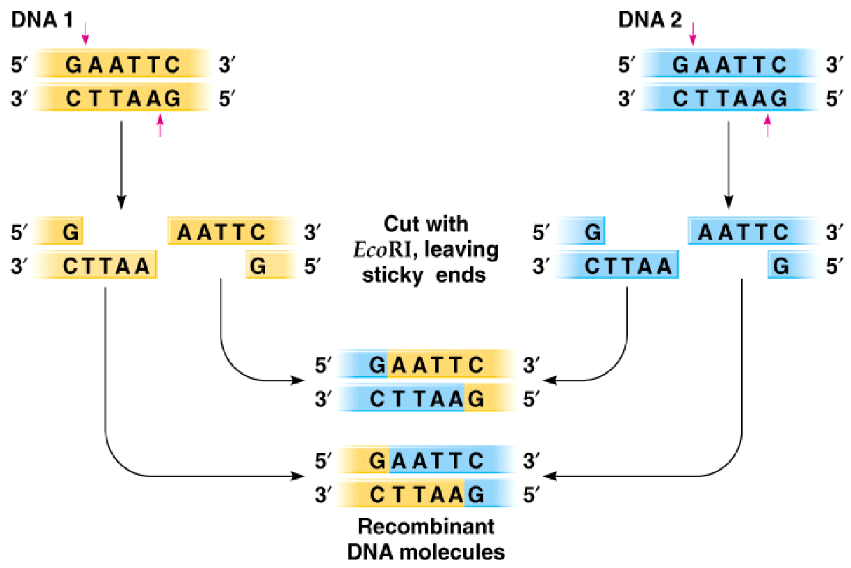
Cut and ligate 2 DNAs with EcoRI ---> recombinant DNA

Slide 24
Applications of Recombinant DNA technologies
pharmaceutical products
• insulin – cheaper and safer compared to animal insulin
• vaccine sub-unit (against hepatitis B) – safer since will not be infected by pathogens
• DNA of vaccines against malaria, influenza etc.
gene therapy
• replacing defective or missing gene with normal gene using adeno~ and retrovirus as vector
gene silencing
• known as RNA interference (RNAi) using dsRNA called short interfering RNA (siRNA) that target specific gene (mRNA) and degrade it

Slide 25
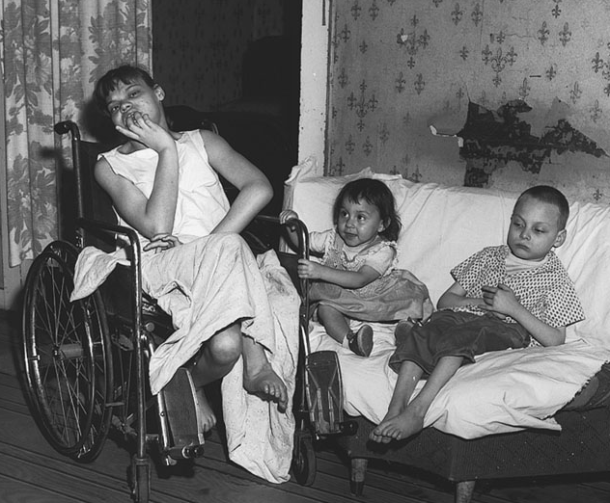
Enzyme Deficiency and Health
Most genetic disorders are due to a deficiency in enzyme function.
This archival photo shows three children with the enzyme (phenylalanine hydroxylase ) deficiency that causes phenylketonuria.

Slide 26
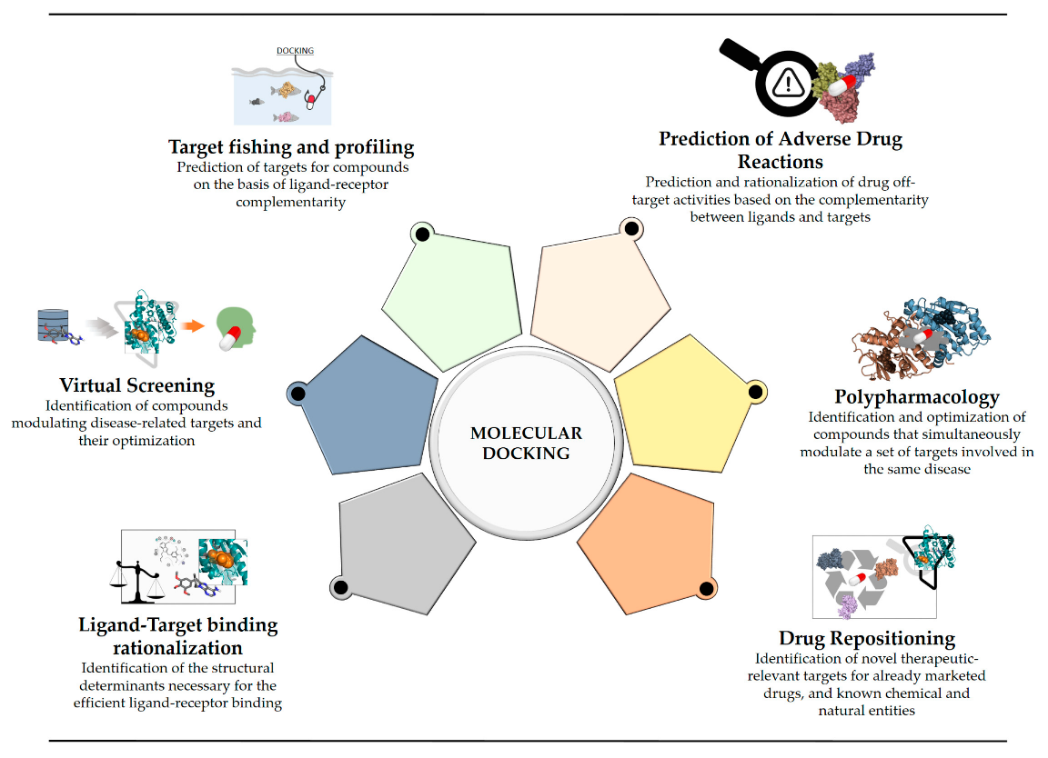
MOLECULAR DOCKING-DRUG DISCOVERY
https://www.uniprot.org/uniprot/P01308

Slide 27
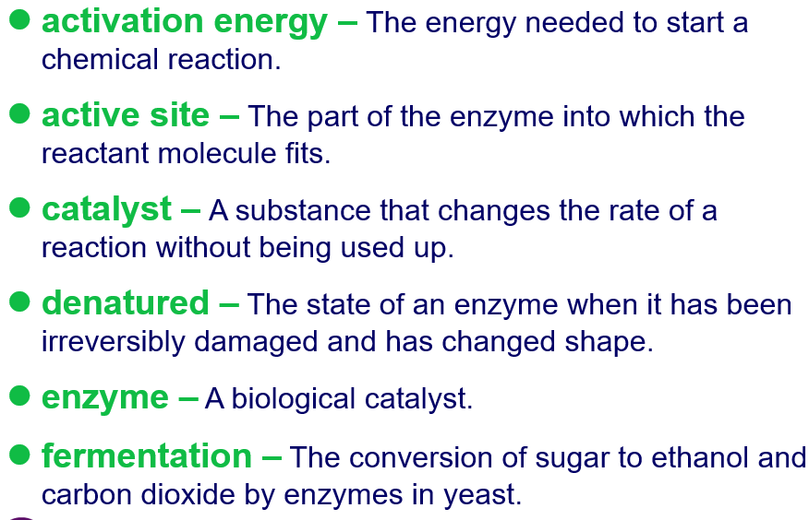

Slide 28
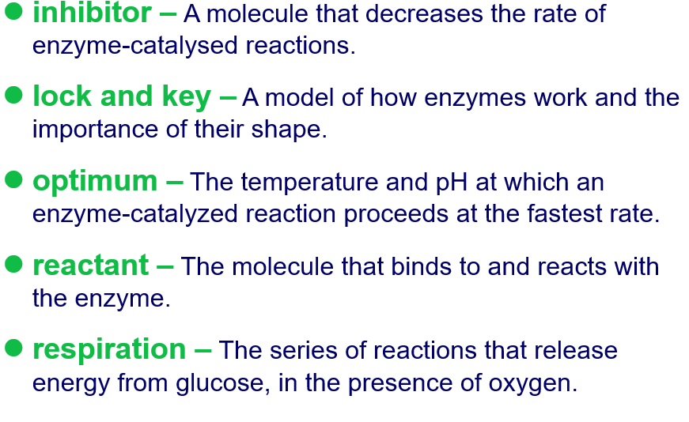

Slide 29
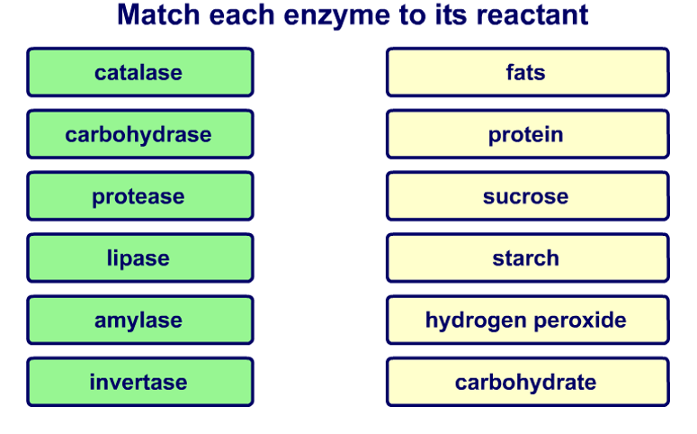

Slide 30
Thank you

